Slide 1
Motivation & Objective
Ride Hailing Apps Pricing Analysis and Prediction
EAS 503 GROUP – 28
Ride Hailing Apps Pricing Analysis and Prediction
Ride-hailing apps are widely used to hire vehicles and the driver as a convenient mode of commute.
Although the source and destination are unchanged or the distance of commute for different locations remains the same, customers most might need to pay different price for same travel distance.
Objective - Build a model that can help us to make prediction of the posterior price.
Project Planning
Obain Dataset
Create Normalized Database
Data Analysis
Data Visualization
Predictive Analysis
Presentation & Report

Slide 2
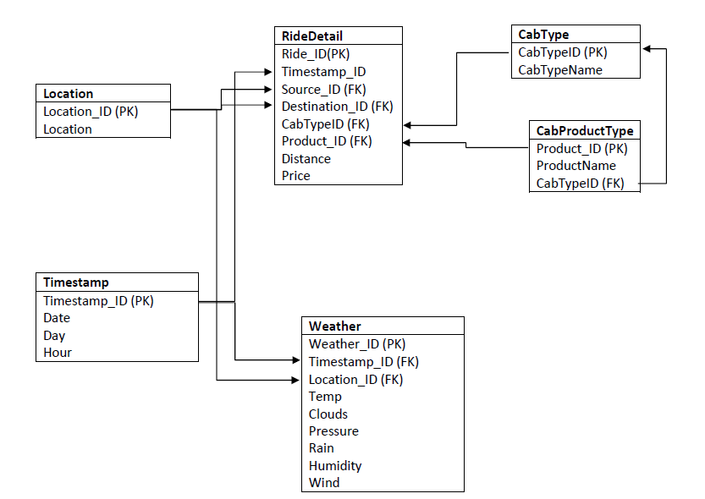
Database Schema
Ride Hailing Apps Pricing Analysis and Prediction
EAS 503 GROUP – 28

